Slide 1
ServiceNow Corporate PowerPoint Template
July 2025 v1.1

Slide 2
V1.1 updates — July 1, 2025
Corporate PowerPoint Template changes and additions
Optimized core template
Additional tools and slides now available in the ServiceNow Corporate Template Toolkit
Added “confidential” cover options
Updated chart styles
Updated table styles
Newly designed font check
Updated icon styles
Additional optimization and bug fixes

Slide 3
Quick-start for Windows
How do I install the new template?
One
Two
Three
Save the template to your machine.
Click “File” then “Save As.”
Make sure the file type is PowerPoint Template (.potx).
By default, PowerPoint will save to the Custom Office Templates folder; save the file there.
Delete old templates from your machine.
If you have any old templates saved to your machine, delete them in the “File” > “New from Template” dialog.
Right-click the old template thumbnail and select “Delete.”
Note: templates you want to delete must not be in use / open.
Create a new file using the template.
Click “File” then “New” then select “Custom / Personal.”
Under “Custom / Personal” select the “ServiceNow Corporate Template” option.

Slide 4
Quick-start for macOS
How do I install the new template?
One
Two
Three
Save the template to your machine.
Click “File” then “Save As Template.”
Make sure the file type is PowerPoint Template (.potx).
By default, PowerPoint will save to the Templates folder; save the file there.
Delete old templates from your machine.
If you have any old templates saved to your machine, navigate there (Documents > Custom Office Templates) and delete them.
Create a new file using the template.
Click “File” then “New from Template.”
Select the template from the thumbnails and click “Create.”

Slide 5
Template tools and tips

Slide 6


Font check
Confirm ServiceNow Sans is displaying properly
This template uses our custom font, ServiceNow Sans.
Use the checker to the right to ensure you have the font installed.
If you do not have the font, download and install it from the Brand Center. After installing the font, be sure to quit PowerPoint and re-open.
Rg
Tf
Do both rows look the same?
Yes. Great, you have the fonts installed.
No. Download and install fonts from the Brand Center.
ServiceNow Sans Bold
ServiceNow Sans Light

Slide 7
Two-tone type
The two-tone type treatment is a signature element in the ServiceNow brand. Here is guidance to create this instantly recognizable look.
Always start with Wasabi Green, then highlight the key
message.
Create natural line breaks. Decide when to begin a new line by how it would be read, like after a pause created by a comma or the next step in directions.

Slide 8


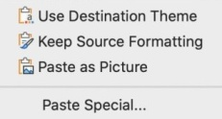

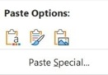
Importing slides from other templates
When pasting slides from one presentation into another, a “Paste Options” menu will appear with three choices: “Use Destination Theme, Keep Source Formatting, and Paste as Picture.”
Choose “Use Destination Theme.”
Theme colors
Will automatically update to the new template, and you may need to adjust some manually.
Pasting text
Use “Paste and Match Formatting” to avoid introducing new fonts.
Recommendation
Like to minimize formatting and have a clean template? Read on.
Paste your on-slide content onto a similar layout in the new template.
Choose the option “Use destination theme” to retain the original style.
Windows
macOS

Slide 9
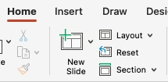
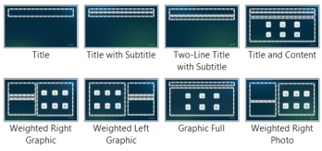
Use layouts within this template
Applying a slide layout
With a slide selected, click on the “Home” tab.
Select the “Layout” flyout menu.
Choose the Layout that is most appropriate for your content.
Resetting a slide layout
With a slide selected, click on the “Home" tab.
Select the “Reset” button in the upper left corner of the menu to update Layout formatting. This updates the placeholder location, text size, spacing, color, etc.

Slide 10
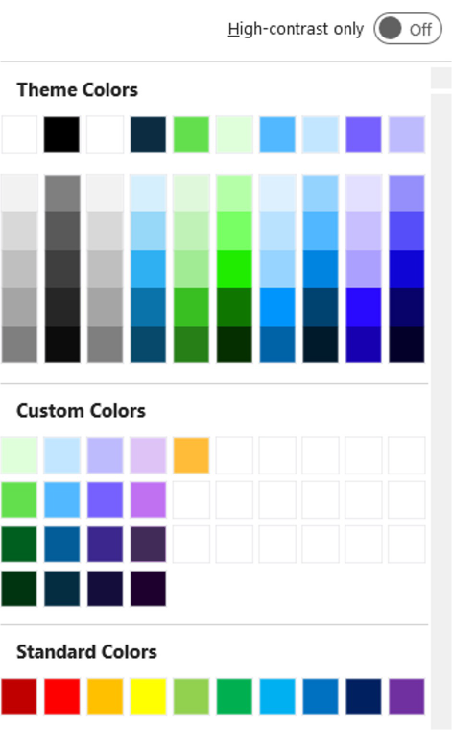
Using PowerPoint color chips
Looking for more guidance? Visit the brand site
Theme Colors are created from the brand color palette and in a specific order. This has many benefits, like generating more easily read data visualizations like charts and graphs.
PowerPoint auto-generates tints and shades based on the primary theme colors. These are not in the brand palette.
Custom Colors are the full brand color palette.
Negative or a warning #FFBC39 RGB 255/188/57
Wasabi Green, positive or growth #63DF4E RGB 99/223/78
Standard Colors are default colors in PowerPoint and not generated from the brand palette.

Slide 11


Object styles
Shape styles
3D shapes
Basic glass
Emphasis glass
Drop shadow
#FFBC39 RGB: 255/188/57
#DEFFD9
RGB: 223/255/217
#63DF4E RGB: 99/223/78
#005F1E RGB: 0/95/30
#003310 RGB: 0/51/16
1
1
#C2E6FF RGB: 194/230/255
#52B8FF RGB: 82/184/255
#035D99 RGB: 3/93/153
#032D42
RGB: 3/45/66
Aa Bb Cc
Aa Bb Cc
#BDBAFD
RGB: 189/186/253
#7661FF
RGB: 118/97/255
#3C288D RGB: 60/40/141
#14103B
RGB: 20/16/59
#DEC3F7
RGB: 222/195/247
#BF71F2 RGB: 191/113/242
#412C58 RGB: 65/44/88
#1E012E
RGB: 30/1/46
11

Slide 12
Object styles
Line styles and callouts
0.75pt
Callout auto-adjusts to height based on the amount of content. Adjust the width as needed.
2pt
3pt
Line weights
Callout auto-adjusts to height based on the amount of content. Adjust the width as needed.
Dashed line
Leader line
Single line callout
Single line callout in Wasabi
Glass callout. Emphasis glass over basic glass.
Single line callout
Single line callout

Slide 13
Glass containers
Basic glass container
This can also be used as a de-emphasized state.
Emphasis glass container
Used selectively or in comparison to the de-emphasized style.
Glass container with shadow
Add a shadow to a solid shape set behind your glass shape.

Slide 14

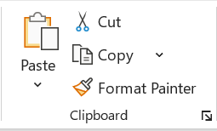
Applying styles to shapes
Use ”Format Painter” or copy and paste object styles
1
2
Select the object with the style you want to copy. In the Home Tab, click the Format Painter.
Keyboard shortcut: Windows macOS
Click the target object and it will adopt the style you loaded into the painter.
Keyboard shortcut: Windows macOS
Ctrl + Shift + C
Cmd + Shift + C
Ctrl + Shift + V
Cmd + Shift + V

Slide 15
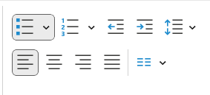
How to use list levels
List levels are a quick and consistent way to style type
This is the first level and is ServiceNow Sans Light 18pt.
Tab once to change to the second level. This is ServiceNow Sans Light 16pt.
The third level tabs in one more level and the font is now 14pt.
Tab one more time to the fourth level.
Tab one more time to the fifth level. This is the furthest inset bullet.
Need to go up a level?
SHIFT+TAB returns up one level.
SHIFT+TAB returns up one level.
SHIFT+TAB Up a level.
SHIFT+TAB once more and you have returned to the top.
Use TAB and SHIFT+TAB to change levels.
This is also available in the Home Tab ribbon bar. These icons are active when it is possible to “Indent More” or “Indent Less.”

Slide 16
Cover green
Speaker first and last name
Job title and company

Slide 17
Cover blue
Speaker first and last name
Job title and company

Slide 18
Cover indigo
Speaker first and last name
Job title and company

Slide 19
Cover with multiple speakers
Speaker first and last name
Speaker first and last name
Speaker first and last name
Speaker first and last name
Job title and company
Job title and company
Job title and company
Job title and company

Slide 20
Cover with subtitle
Optional subtitle
Speaker first and last name
Job title and company

Slide 21
Table of contents
01 | One
02 | Two
03 | Three
04 | Four
05 | Five
To add or subtract table rows, select the table and go to the Table Layout Tab or right-click on the table.
To add a row, select “Insert Row Above” or “Insert Row Below.”
To delete a row, select your row and select “Delete” and “Delete Rows.”
Then adjust the table height to fit into the glass shape.
Source

Slide 22
Executive summary
Two-line header content | Summary detail Summary detail Summary detail
Two-line header content | Summary detail Summary detail Summary detail
Two-line header content | Summary detail Summary detail Summary detail
To add or subtract table rows, select the table and go to the Table Layout Tab or right-click on the table.
To add a row, select “Insert Row Above” or “Insert Row Below.”
To delete a row, select your row and select “Delete” and “Delete Rows.”
Then adjust the table height to fit into the glass shape.
Source

Slide 23

Speaker first and last name
Job title
Company

Slide 24


Speaker first and last name
Speaker first and last name
Job title
Company
Job title
Company

Slide 25

Speaker first and last name
Speaker first and last name
Speaker first and last name
Job title
Company
Job title
Company
Job title
Company

Slide 26
Title only
Source

Slide 27
Title with subtitle
Optional subtitle
Source

Slide 28
Two-line title and subtitle
Optional subtitle
Source

Slide 29
Title and content
Optional subtitle
First level ServiceNow Sans Light 18pt
Second level ServiceNow Sans Light 16pt
The ServiceNow AI Platform for business transformation
ServiceNow AI Platform unifies AI + Data + Workflows
Third level ServiceNow Sans Light 14pt
Fourth level ServiceNow Sans Light 14pt
Fifth to ninth level ServiceNow Sans Light 14pt
Let AI and automation transform experiences with ServiceNow CRM. Inspire loyalty, boost productivity, and grow revenue.
Link ServiceNow Sans Light
Source

Slide 30
Two-line title and content
Optional subtitle
First level ServiceNow Sans Light 18pt
Second level ServiceNow Sans Light 16pt
The ServiceNow AI Platform for business transformation
ServiceNow AI Platform unifies AI + Data + Workflows
Third level ServiceNow Sans Light 14pt
Fourth level ServiceNow Sans Light 14pt
Fifth to ninth level ServiceNow Sans Light 14pt
Let AI and automation transform experiences with ServiceNow CRM. Inspire loyalty, boost productivity, and grow revenue.
Link ServiceNow Sans Light
Source

Slide 31
Title with two columns and headers
Optional subtitle
Subhead
Subhead
First level ServiceNow Sans Light 18pt
Second level ServiceNow Sans Light 16pt
Third level ServiceNow Sans Light 14pt
Fourth level ServiceNow Sans Light 14pt
Fifth to ninth level ServiceNow Sans Light 14pt
Let AI and automation transform experiences with ServiceNow CRM.
Link ServiceNow Sans Light
First level ServiceNow Sans Light 18pt
Second level ServiceNow Sans Light 16pt
Third level ServiceNow Sans Light 14pt
Fourth level ServiceNow Sans Light 14pt
Fifth to ninth level ServiceNow Sans Light 14pt
Let AI and automation transform experiences with ServiceNow CRM.
Link ServiceNow Sans Light
Source

Slide 32
Title with three columns and headers
Optional subtitle
Subhead
Subhead
Subhead
First level ServiceNow Sans Light 18pt
Second level 16pt
Third level 14pt
Fourth level 14pt
Fifth to ninth level 14pt
Link ServiceNow Sans Light
First level ServiceNow Sans Light 18pt
Second level 16pt
Third level 14pt
Fourth level 14pt
Fifth to ninth level 14pt
Link ServiceNow Sans Light
First level ServiceNow Sans Light 18pt
Second level 16pt
Third level 14pt
Fourth level 14pt
Fifth to ninth level 14pt
Link ServiceNow Sans Light
Source

Slide 33
Title with four columns and headers
Optional subtitle
Subhead
Subhead
Subhead
Subhead
First level ServiceNow Sans Light 18pt
Second level 16pt
Third level 14pt
Fourth level 14pt
Fifth to ninth level 14pt
Link
First level ServiceNow Sans Light 18pt
Second level 16pt
Third level 14pt
Fourth level 14pt
Fifth to ninth level 14pt
Link
First level ServiceNow Sans Light 18pt
Second level 16pt
Third level 14pt
Fourth level 14pt
Fifth to ninth level 14pt
Link
First level ServiceNow Sans Light 18pt
Second level 16pt
Third level 14pt
Fourth level 14pt
Fifth to ninth level 14pt
Link
Source

Slide 34
Weighted right content
Optional subtitle
Level one ServiceNow Sans Light 18pt
Level two ServiceNow Sans Light 16pt
Level three ServiceNow Sans Light 14pt
Source

Slide 35
Weighted left content
Optional subtitle
Level one ServiceNow Sans Light 18pt
Level two ServiceNow Sans Light 16pt
Level three ServiceNow Sans Light 14pt
Source

Slide 36
Weighted right graphic
Optional subtitle
The content placeholder on the right can contain charts, tables, and images.
Level one ServiceNow Sans Light 18pt
Level two ServiceNow Sans Light 16pt
Level three ServiceNow Sans Light 14pt
Source

Slide 37
Weighted left graphic
Column header | Column header
Banded rows are more clearly read. | Infinite Blue fill
To achieve the banded row style, start with a fill of Infinite Blue followed by a row with no fill. | No fill
ServiceNow Sans Light | Infinite Blue fill
ServiceNow Sans Light | No fill
Highlight rows or columns with a Wasabi outline | Create a highlight with the Table Design options, recommended, or create a shape around the row with no fill and a 2pt line.
Optional subtitle
The content placeholder on the left can contain charts, tables, and images.
Level one ServiceNow Sans Light 18pt
Level two ServiceNow Sans Light 16pt
Level three ServiceNow Sans Light 14pt
Source

Slide 38
Quote, this layout can use multiple lines of text, the top quote mark will move automatically.
Speaker first and last name
Job title and company

Slide 39
Large statement that spans multiple lines, recommend beginning with a wasabi highlight.

Slide 40
Large statement that spans multiple lines, recommend beginning with a wasabi highlight.

Slide 41
Large statement that spans multiple lines, recommend beginning with a wasabi highlight.

Slide 42
Divider green
Optional subtitle

Slide 43
Divider blue
Optional subtitle

Slide 44
Divider indigo
Optional subtitle

